Slide 1




EU–Tanzania Investment & Business Forum 2026
01 | SNAPSHOT
Tanzania Power Sector: Scale, Growth & Investment Need
A growing electricity market with industrial demand, regional trade potential and a clear investment pipeline.
WHERE WE ARE TODAY
WHERE WE ARE GOING
OUR ROLE IN THE MARKET
National electricity utility across generation, transmission, and distribution, with about 4.6 GW of installed generation capacity, approximately 8,519km of transmission infrastructure, and a 229,600km distribution network serving 6.3 million customers.
Targeting 8GW installed capacity by 2030, supported by grid expansion, new connections and productive demand.
Links demand with generation, grid, storage and service solutions — partnering with investors, financiers and LPUs.
11–15%
EAPP + SAPP
DEMAND GROWTH
REGIONAL MARKET
Peak demand is growing at about 11–15% a year. Mining, industries, SEZs, agribusiness , and digital economy data centres are adding loads.
Interconnections position TANESCO to serve domestic growth and cross-border electricity trade.
DEMAND GROWTH + 8,000 MW TARGET + REGIONAL MARKET → STRONG CASE FOR PARTNERSHIP
Marietha Kileo • Head of Investment Desk, TANESCO
TANESCO 1 / 7
Notes:
Source: SEMI FINAL PPT EU TANZANIA BUSINESS FORUM 2026(1).pptx, slide 3. Original snapshot wording retained. The approximately 4.6 GW figure is national installed capacity, not TANESCO-owned capacity. Presenter follows the supplied Italy session programme.

Slide 2
EU–Tanzania Investment & Business Forum 2026
02 | OPPORTUNITIES
Opportunities in Tanzania’s Growth Sectors
Productive sectors require generation, transmission, substations, distribution, storage and power-quality solutions.
MINING & MINERAL PROCESSING
AGRIBUSINESS & VALUE ADDITION
DIGITAL ECONOMY
REGIONAL POWER MARKET
Large loads are already emerging.
Mining expansion and mineral value addition require reliable, high-capacity power.
2026 examples: GGM • Shanta • Chunya • Mahenge
ENERGY NEED: Grid connections • HV lines • substations • supply for processing
Power across the value chain
Electricity enables agriculture to move from production into higher-value activities.
Demand drivers: irrigation & pumping • agro-processing • cold storage & warehouses
ENERGY NEED: Grid extensions • substations • distribution networks
Data centres = 24/7 demand
Data centres create large, continuous and quality-sensitive electricity loads.
Investor requirements: high-capacity supply • redundant connections • power quality & BESS
ENERGY NEED: Dedicated, scalable power infrastructure
A market beyond Tanzania
Interconnections position the power sector to serve domestic and cross-border demand.
Market access: EAPP • SAPP • cross-border electricity trade
ENERGY NEED: Interconnectors • transmission expansion • tradable generation capacity
WHAT THIS CREATES: GENERATION + TRANSMISSION + SUBSTATIONS + DISTRIBUTION + STORAGE → INVESTMENT OPPORTUNITY
TANESCO 2 / 7

Slide 3
EU–Tanzania Investment & Business Forum 2026
03 | EU PIPELINE
Priority Projects for the EU Mission
PROJECT | CATEGORY | COST | WHAT IS NEEDED
Rumakali hydro, 222 MW + 64 km 220 kV line | Generation | US$634.50m | Resettlement and financing / PPP assessment
Manyoni Solar PV, 100 MWp | Generation | US$79.60m | PPP investment and remaining compensation
400 kV Sumbawanga–Mpanda–Kigoma, 526 km* | Transmission | US$292.00m | Construction financing; studies complete
400 kV Rufiji–Kibiti–Mkuranga, 224 km | Transmission | US$91.84m | Feasibility, ESIA and RAP study financing
Uganda–Tanzania link + Mafia hybridisation | Interconnection | €669.00m | RAP preparation and concessional co-financing
Tanzania–Malawi interconnector | Interconnection | US$82.00m | Complete cross-border studies and financing
Kidatu Hydropower Plant | Rehabilitation | ≈€200m** | Feasibility and rehabilitation investment
Mtera + Nyumba ya Mungu hydropower | Rehabilitation | TBD after FS | Study delivery and investment structuring
*Includes substations and Katavi rural electrification. **Kidatu: indicative investment estimate; final cost after feasibility.
All costs are indicative project/package costs, not remaining funding gaps. FS = feasibility study.
TANESCO 3 / 7
Notes:
Suggested speaking time: 1 minute 45 seconds.
We have organised the pipeline into four categories: generation, transmission, interconnection and rehabilitation. Generation includes Rumakali, 222 MW plus a 64-kilometre 220 kV line, at 634.5 million US dollars, and Manyoni Solar, 100 MWp, at 79.6 million dollars. Rumakali is under PPP viability assessment and needs resettlement implementation and financing. Manyoni is listed for PPP with studies complete and compensation partly paid.
Transmission is critical to move power to customers. The 526-kilometre 400 kV Sumbawanga–Mpanda–Kigoma package, including substations and Katavi rural electrification, costs 292 million dollars. Studies and RAP are complete and construction financing is needed; AfDB interest is noted. The 224-kilometre 400 kV Rufiji–Kibiti–Mkuranga line, at 91.84 million dollars, needs feasibility, ESIA and resettlement studies, with a funding request submitted to Swedfund.
Interconnection includes the Uganda–Tanzania link and Mafia Island hybridisation package at 669 million euros. It is a combined package, not the standalone line cost. Feasibility/EIA are complete; RAP consultant procurement is ongoing. The source lists a 35.7 million euro EU grant and interest from AFD, the World Bank and JICA. The Tanzania–Malawi link is 82 million dollars, with Tanzania-side feasibility complete and Malawi-side work ongoing.
Rehabilitation includes Kidatu and Mtera/Nyumba ya Mungu. For Kidatu the source cost column says final cost after feasibility, while its maturity remarks give an indicative 200 million euro investment estimate and potential EU/EIB blending. We therefore show the estimate with an explicit caveat. For Mtera/Nyumba ya Mungu no investment estimate is available. Swedfund has committed to study support, with the grant agreement under review/finalisation. Study delivery and subsequent investment preparation remain the opportunity.
All costs are indicative project or package costs, not verified residual financing needs. Financing interest is not a commitment or an open tender. Across the four categories, grid connections and reliability upgrades enable agro-processing, cold chains and digital infrastructure, with customer-specific solutions requiring load and site studies.
Source: Pipeline Projects-TANESCO(1).docx, Proposed Energy Pipeline for Roadshows in Europe, entries 1, 11, 7, 8, 5, 14, 10 and 9. Classification follows the user’s four requested categories while preserving combined package scope. Source currencies are unchanged. No cross-currency total is presented.

Slide 4
EU–Tanzania Investment & Business Forum 2026
04 | GENERATION
Hydropower & Geothermal Generation Projects
Large-scale renewable baseload open to PPP, concessional and co-financing partners.
PROJECT | TECHNOLOGY | EST. COST | STATUS / WHAT IS NEEDED
Ruhudji Hydropower, 358 MW | Hydro | US$968.37m | FS & EIA complete; RAP pending; fund needed
Kikonge Multipurpose Dam, 321 MW + 4,200 ha irrigation + 220 kV line | Hydro + irrigation | US$807.12m | Financing to complete FS & EIA fund needed
Rumakali Hydropower, 222 MW + 64 km 220 kV line | Hydro | US$634.50m | FS & EIA complete; RAP pending; fund needed
Ngozi Geothermal, Mbeya, 70 MW | Geothermal | US$335.89m | Exploratory drilling; EIA certified; fund needed
Kiejo–Mbaka Geothermal, Mbeya, 60 MW | Geothermal | US$287.90m | Exploratory drilling (resource confirmation); EIA certified, study fund needed
Geothermal financing modality: GoT / concessional loan / PPP. Kikonge co-sponsored with NIRC.
Costs are indicative. FS = feasibility study; EIA = environmental impact assessment; RAP = resettlement action plan; GCF = Green Climate Fund.
TANESCO 4 / 7

Slide 5
EU–Tanzania Investment & Business Forum 2026
05 | TRANSMISSION
Transmission Projects Open for Investment
Early-win IPT lines to mines, SEZs and industrial parks, backed by customer offtake commitments.
PROJECT | VOLTAGE | EST. COST | STATUS / WHAT IS NEEDED
Chalinze–Segera–Tanga & Chalinze–Bagamoyo, 335 km | 400 / 220 kV | US$272.99m | FS complete (Sep 2024); implementation financing
Chalinze–Bagamoyo upgrade, ~90 km* | 400 kV | US$120–150m | Concept stage; dedicated feasibility study
Chalinze–Kwala industrial line | 220 kV | US$120.00m | Pre-FS complete; ESIA, RAP and financing
Songea–Mbinga, 102 km | 220 kV | US$51.53m | FS complete (May 2024); implementation financing
Imalilo–Bunda, 102 km | 220 kV | US$45.60m | Pre-FS complete; ESIA/RAP ongoing; financing
Mahumbika–Ruangwa, 120–150 km | 220 kV | US$80–100m | Priority project; feasibility study to start
Shinyanga–Bunda–Kirgoris, 645 km | 400 kV | US$325.20m | FS & ESIA complete; implementation financing
*Proposed 400 kV upgrade of the 220 kV Chalinze–Bagamoyo segment in the first project; not additive to it.
Costs are indicative estimates. FS = feasibility study; ESIA = environmental & social impact assessment; RAP = resettlement action plan.
TANESCO 5 / 7

Slide 6
EU–Tanzania Investment & Business Forum 2026
06 | PARTICIPATION
Flexible Investment and Partnership Structures
Partners can enter through capital investment, co-financing, EPC, technology and technical services.
IPP
Private investors develop generation and sell power under power-purchase arrangements.
PPP
Government and private partners can jointly structure strategic energy infrastructure.
IPT
Private capital can participate in transmission as the IPT framework develops; a pilot project is in progress.
ODA / DFI
Development partners can support projects through concessional finance, grants, export credit and DFI instruments.
DIRECT / JV
Partners can invest directly through equity participation or joint ventures.
EPC, EQUIPMENT SUPPLY, STORAGE, AUTOMATION, ENGINEERING AND CONSULTANCY SERVICES
Partners can also provide equipment, storage, automation, engineering, EPC and project services.
TANESCO 6 / 7
Notes:
Sources: SEMI FINAL PPT EU TANZANIA BUSINESS FORUM 2026(1).pptx, slides 11, 13 and 14. Original participation and engagement wording retained. The structures remain subject to applicable project evaluation, approvals and procurement requirements.

Slide 7
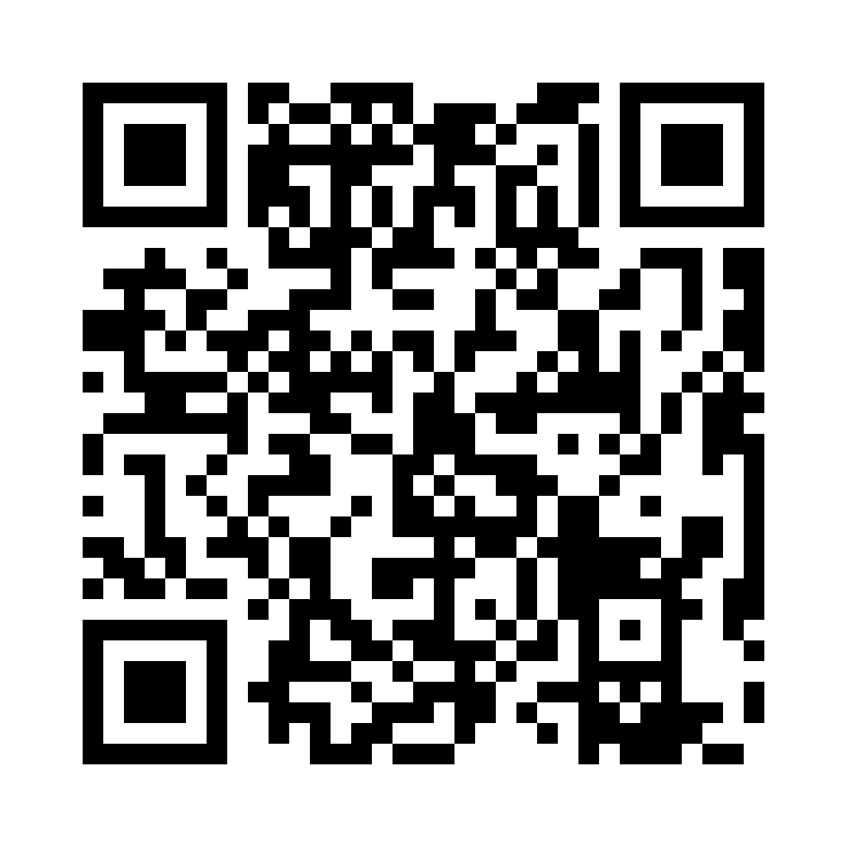
EU–Tanzania Investment & Business Forum 2026
07 | ENGAGEMENT
How to Engage with TANESCO
A clear pathway from first contact to financial close.
From Interest to Bankable Project
01 INITIAL ENGAGEMENT
02 TIMS / PROPOSAL SUBMISSION
03 EVALUATION & STRUCTURING
04 DUE DILIGENCE TO CLOSE
Share interest, capabilities and project focus with the Investment Desk.
Register or submit relevant proposal information through TIMS where applicable.
Screen technical, financial, legal and commercial fit; confirm the right route.
Due diligence, approvals, agreements, financial close and implementation.
Contact Us
Investment Desk: invest@tanesco.co.tz
Investment Portal (TIMS): https://tims.tanesco.co.tz
Scan the QR code to register and submit proposals
TANESCO 7 / 7

