Slide 1

Our experience. Your growth.

Slide 2


at
a glance
a
a

Slide 3
RINA has a global footprint with 200 offices in 70+ Countries
---
---
7.000
colleagues
200
offices
70+
countries
>90
nationalities
75%
educated to degree level, of which 85% STEM
Note: Currently not operative in Russia

Slide 4







  Callout note goes here.
  Callout note goes here.
  Callout note goes here.
  Callout note goes here.
Successful growth
  2024 - RINA consolidated its capabilities in the Naval Engineering sector and Nordics market with the acquisition of
  2025 -
  RINA expands in RE in Spain and Portugal through ongoing acquisition**
Mln €
  2021 - RINA consolidates its presence in the
  US market with the
  acquisition of
  2018 - RINA grows into the Real Estate sector and African market with the acquisition of Comete and the establishment of Rina Value Services
  2016 - RINA expands into the UK Energy market. Acquisition of
  2011 - RINA enters the consulting engineering sector: acquisition of
Rev.
REVENUES
Note: (*) Forecast; (**) under approval of Banco de Espana

Slide 5

Our Business Units
---
---
Energy
RINA’s energy team offers global expertise in site characterization, advisory, engineering, inspections & supervision, supporting energy projects from development to decommissioning, ensuring safety and efficiency.
Marine
RINA’s marine team provides ship classification, statutory certification, advisory, digital and technical services for safety, sustainability, and innovation across commercial, naval, and yachting sectors.
Industry
RINA’s industry team provides highly qualified services, thanks to its multidisciplinary approach and outstanding application expertise across all industrial sectors - including A&D, hard-to-abate industries, management consulting, and cybersecurity.
Certification
RINA’s certification team guides companies on their journey toward continuous improvement and excellence, by certifying organizations’ genuine dedication to best practices.
Infrastructure & Mobility
RINA’s infrastructure & mobility team supports the path to the next generation of infrastructures and buildings by ensuring their safety and efficiency.
Real Estate
RINA’s real estate team supports public and private market operators with innovative services aimed at protecting and enhancing real estate capital value at every stage of the investment.

Slide 6
E2E coverage of assets along their life-cycle
PROJECT MANAGEMENT​
Feasibility ​Study & Planning​
Design
Front End Engineering Design (concept and technical specifications issue)​
Multidisciplinary Design (Civil, HSE, mechanical, electrical, Instrumentation & Control)​
3D integrated engineering​
Material selection and qualification​
Procurement
Bidding preparation​
Expediting to guarantee timely delivery to the destination site​
Vendor Inspection surveillance activities at supplier’s premises
Material Management identify and prevent potential problems in the Supply Chain
Construction and
Commissioning​
Operations and Maintenance
Geotechnical, Geophysical and Environmental Survey
Concept selection (CAPEX and OPEX estimation)
Basic design
Environmental and Social Impact assessment​
HSE Permitting support
Prototyping
Site Supervision project management, construction and QA/QC
Commissioning supervision preparation, testing and hand-over to start-up or operations
Owner Engineering assistance
EHSS monitoring (Environmental Health Safety Social)
Maintenance Engineering Services​
Technical / Safety Inspection​
Life extension studies​
Failure analysis
Decommissioning studies
Common competencies shared across the different reference markets…plus easy and fast access to high level competencies whenever not directly managed​
Current RINA focus:
High
Low

Slide 7
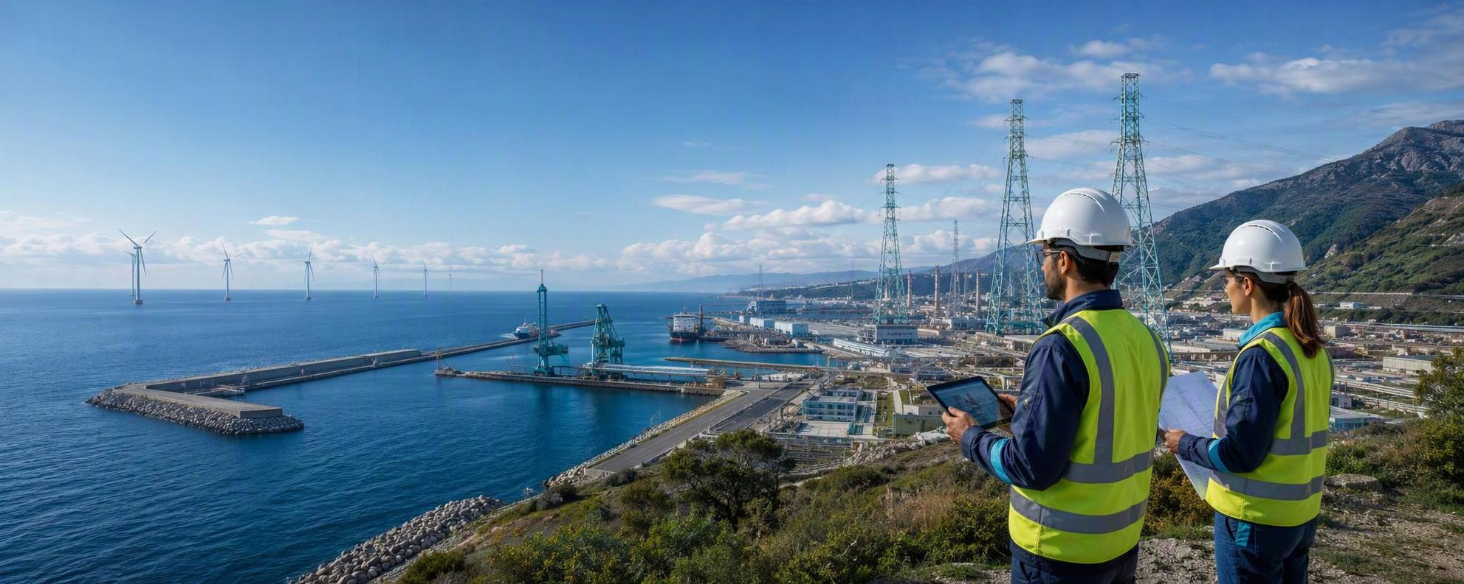
RINA with IFI: Twofold Role
aaaaaaa
Project Financing Advisory Services is one of RINA core business. This market, a niche within the group, is structured to provide high-qualified technical and management advisory services to key private players, public investors, and Lenders’ groups. Within the context of project financing:
RINA acts as independent consultant to Lenders to safeguard the project financial structure prior to funding decision and during construction and operation phases to ensure compliance to project requirements and expected pay back levels
RINA provides advisory services to Project Developers, by producing any bankable studies needed to comply with Lenders Standards.

Slide 8

in Africa
SECTORS / SEGMENTS
Roads & Bridges
Buildings & Urban Planning
Energy & Renewable
Water Infrastructure
Mobility & Transport
Ports & Maritime
Agri-business

Slide 9
RINA’s Presence in Africa
RINA Offices
Project Offices
Algeria
Angola
Cameroon
Congo Brazzaville
Cote d’Ivoire
Egypt
Guinea
Ghana
Libya
Mauritania
Morocco
Mozambique
Nigeria
South Africa
Tunisia
Burkina Faso
Burundi
Benin
Chad
Congo (DRC)
Central African Republic
Ethiopia
Gabon
Kenya
Madagascar
Malawi
Mali
Namibia
Niger
Rwanda
Senegal
Tanzania
Uganda
Zambia

Slide 10

in
Tanzania
a
a

Slide 11
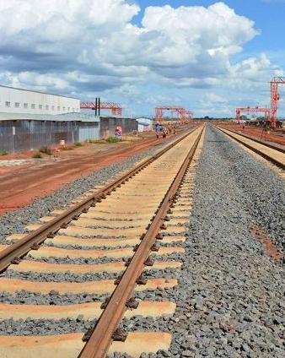

Tanzania Standard Gauge Railway
Tanzania Railway Corporation (TRC)
Tanzania
RINA Consulting is part of the JV performing, on behalf of TRC, the review of design, supervision and management of works carried out by the design and build contractors for all the phases (from 1 to 5) for a total of 1500 + Km railway line linking Dar Es Salaam (Tanzania) with Rwanda, Burundi and Congo.
Design review of rail alignment
Design review of trackwork
Design review of signalling system for Lot 2 and Lot 5 (review of design documentation regarding ERTMS L2, interlocking, wayside equipment and OCC)
Support to the Rolling Stock procurement
11
Notes:
11

Slide 12
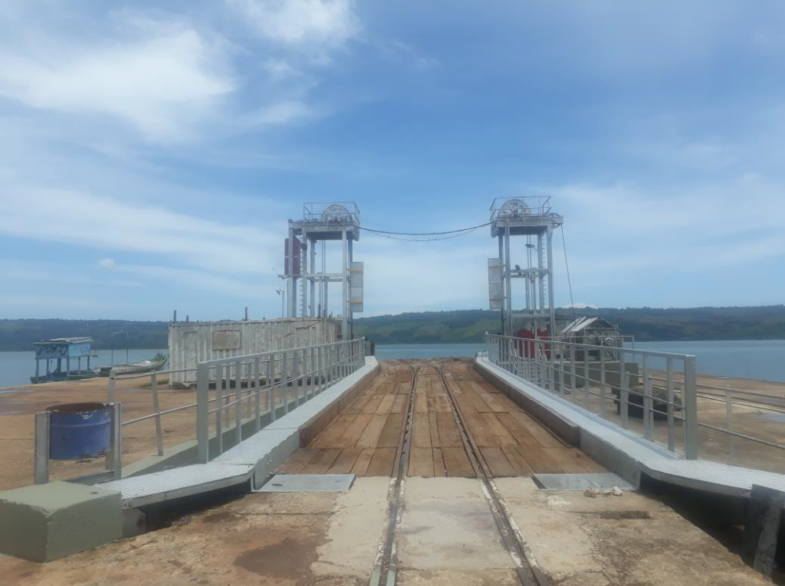
Lake Victoria Ports
Location: Tanzania
Period: 2022-ongoing
Client: Tanzania Port Authority
Project Description
TPA intends to develop the ports infrastructure of Lake Victoria, in order to unlock and integrate the Lake regions in Tanzania with the national and international economy. The commercial ports involved in the program are the Ports of Mwanza, Musoma, Bukoba, Kemondo Bay and Nansio
Provided Services
Traffic forecast
Definition of ports’ development operations
Feasibility studies
Preliminary Design of ports’ infrastructures
Detailed Engineering Design of ports’ infrastructures
ESIA
Tender documents

Slide 13
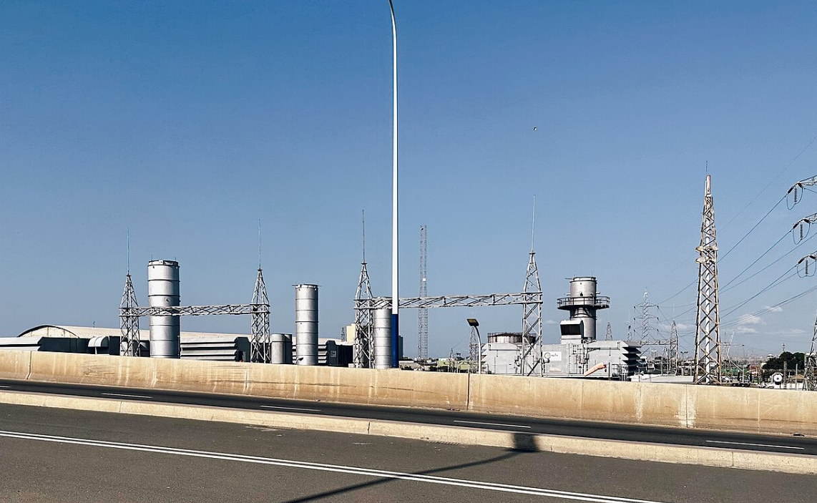
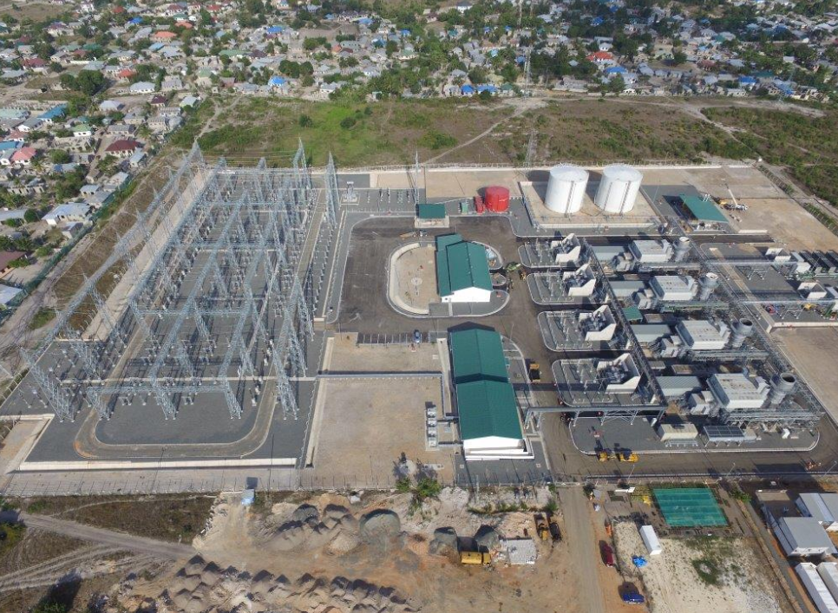
Ubungo and Kynierezi Power Plant
Client: TANESCO
Location: Tanzania
Funds: Confidential
Period: 2024 - 2025
Project Description:
The Scope of the Project is the conversion of the Ubongo (II & III) and Kynierezi Power Plants from Simple Cycle to Combined Cycle Gas Fired Power Plants.
Provided Services:
In this project RINA has been appointed to perform:
Feasibility Study
ESIA
Conceptual Design
EPC Tender Documents
Notes:
13

Slide 14







For more info:
a
a
Thank you for your attention

