Slide 1
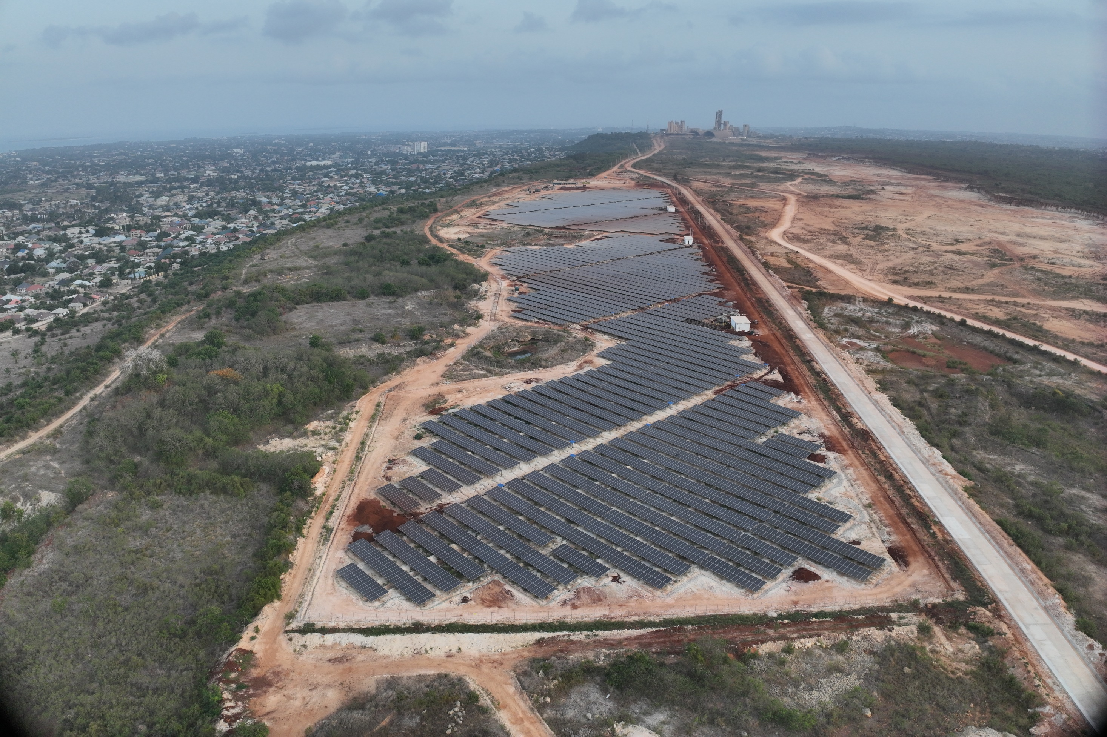

Slide 2


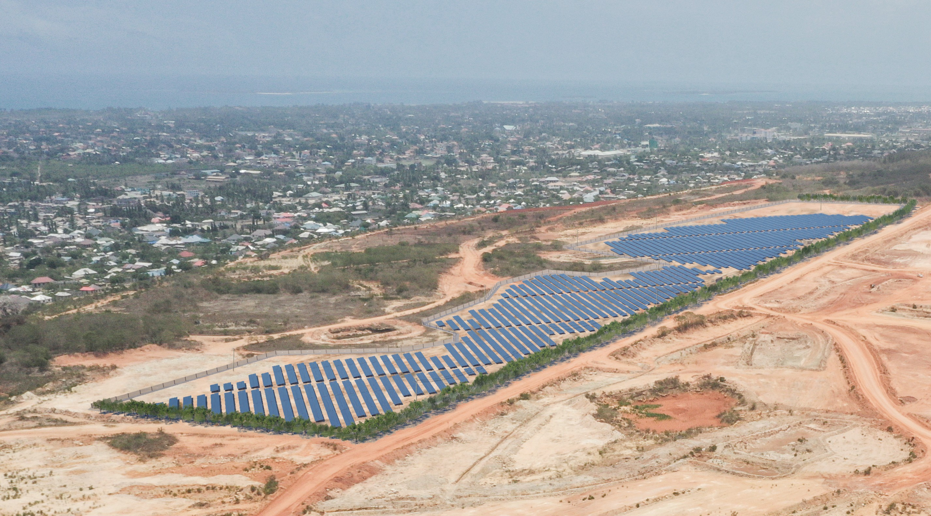
EU-TANZANIA INVESTMENT AND BUSINESS FORUM 2026-2027
ROADSHOW TO EUROPE - ITALY – 1 OCTOBER, CESENA
Twiga Cement Solar Farm A Success Story of EU-TZ Private Sector Co-operation in Renewable Energies

Slide 3




Twiga Cement Solar Farm (https://www.twigacement.com/en/solar-project)
A Success Story of EU-TZ Private Sector Co-operation in Renewable Energies
15 MWp | 26 GWh/year PV plant in a disused area of a limestone quarry of Heidelberg - Twiga Cement factory in Dar Es Salaam
The largest «behind-the-meter» PV plant in Tanzania
Grid-connected to TANESCO Twiga Cement POD
through an internal 3 km long OHTL @ 33 kV
Owner/Developer: Heidelberg Materials (EU)
Design, Permitting, Construction Supervision
(Owner’s Engineering Services) provided by
Studio Santi Ltd, a EU-TZ consultancy
Tanzanian engineers, who provided the OE services,
trained-on-the-job by their EU Colleagues, are here today
It is the EU co-operation and trading style:
Capacity Buidling is always part of the story

Slide 4
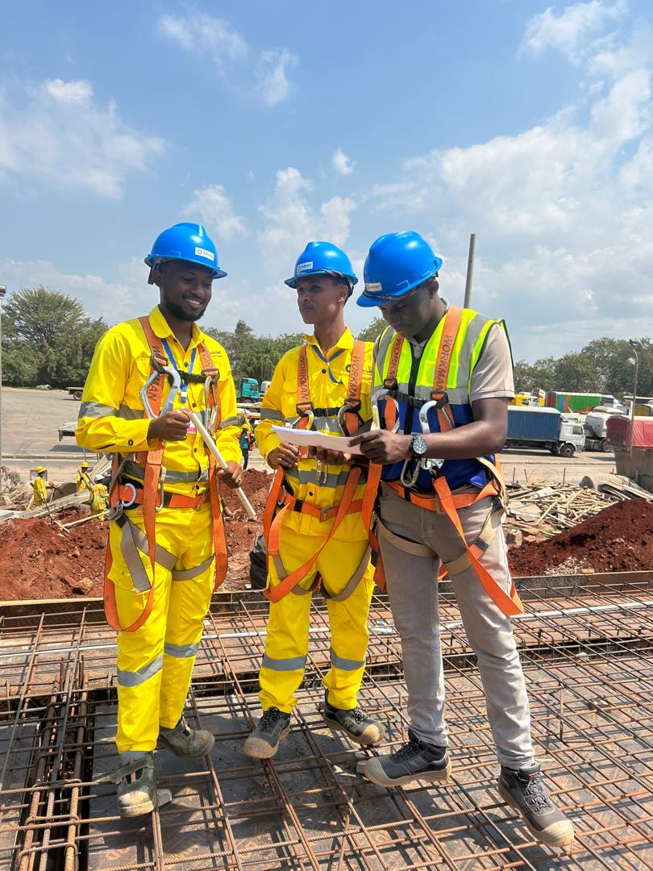
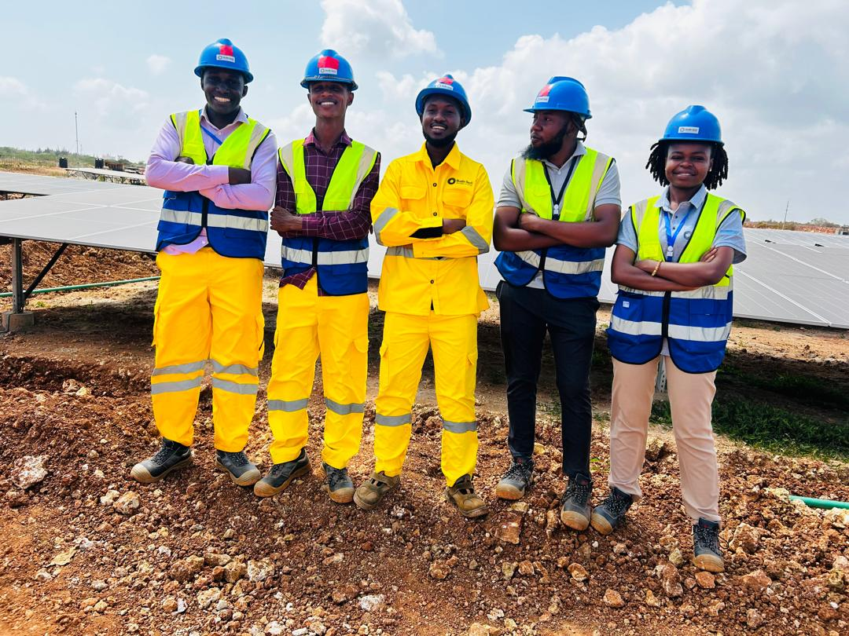
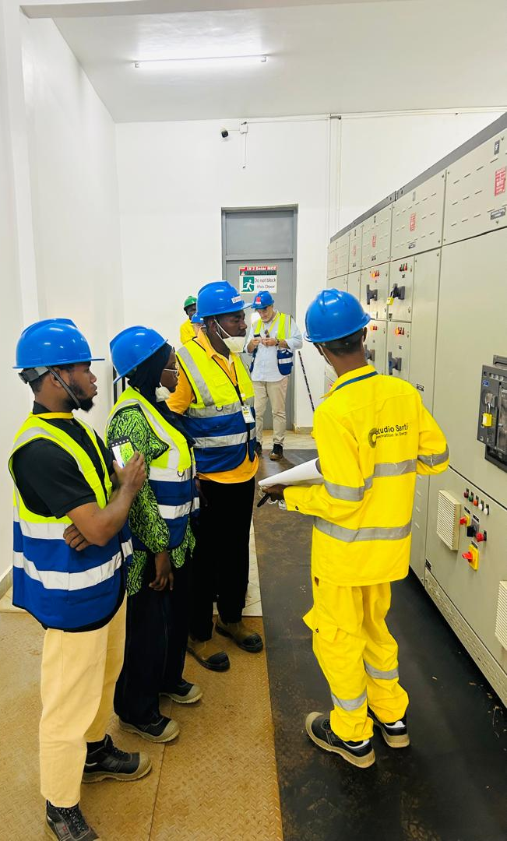
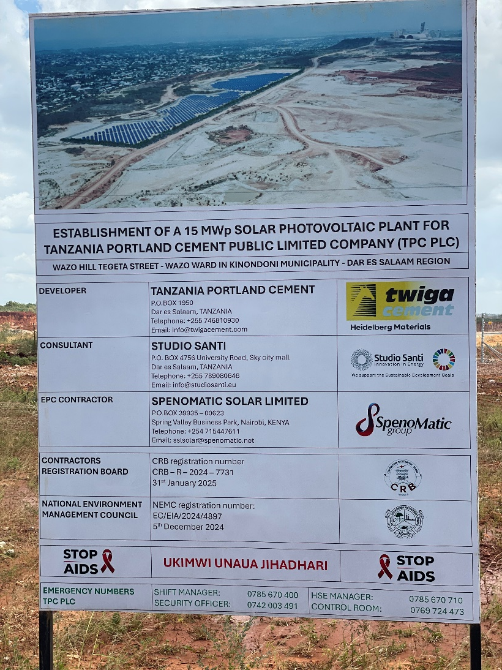
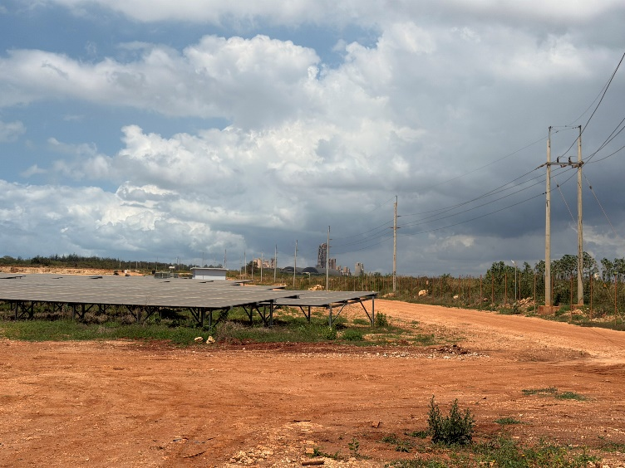
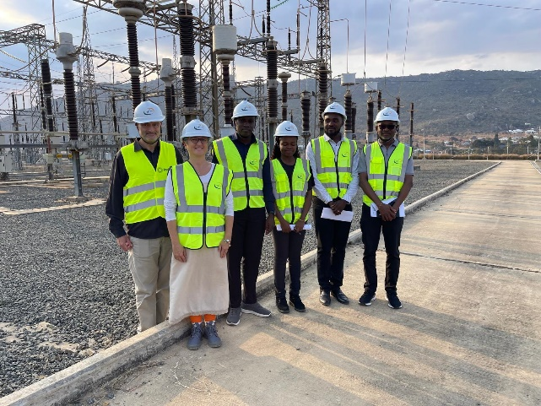
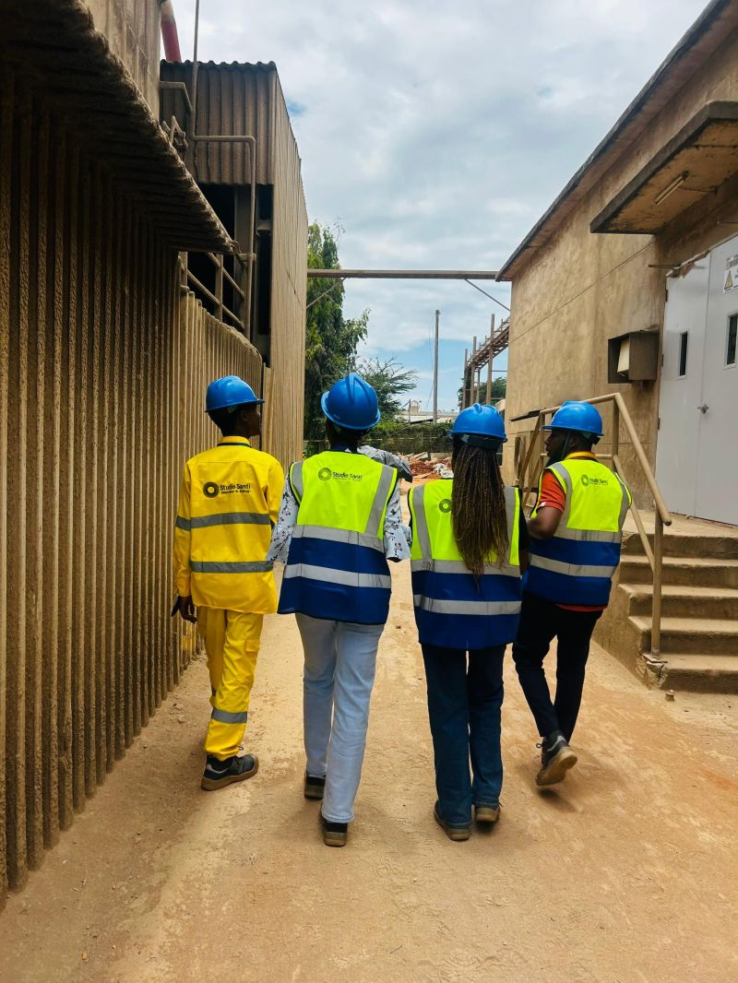
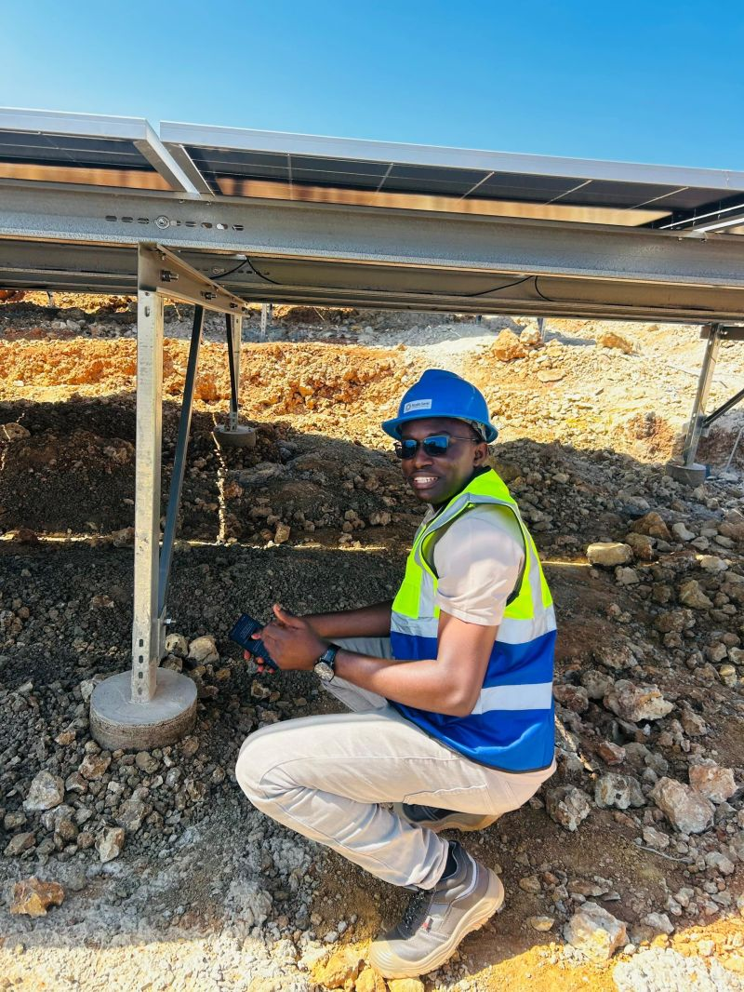
Twiga Cement Solar Farm
A Success Story of EU-TZ Private Sector Co-operation in Renewable Energies

Slide 5
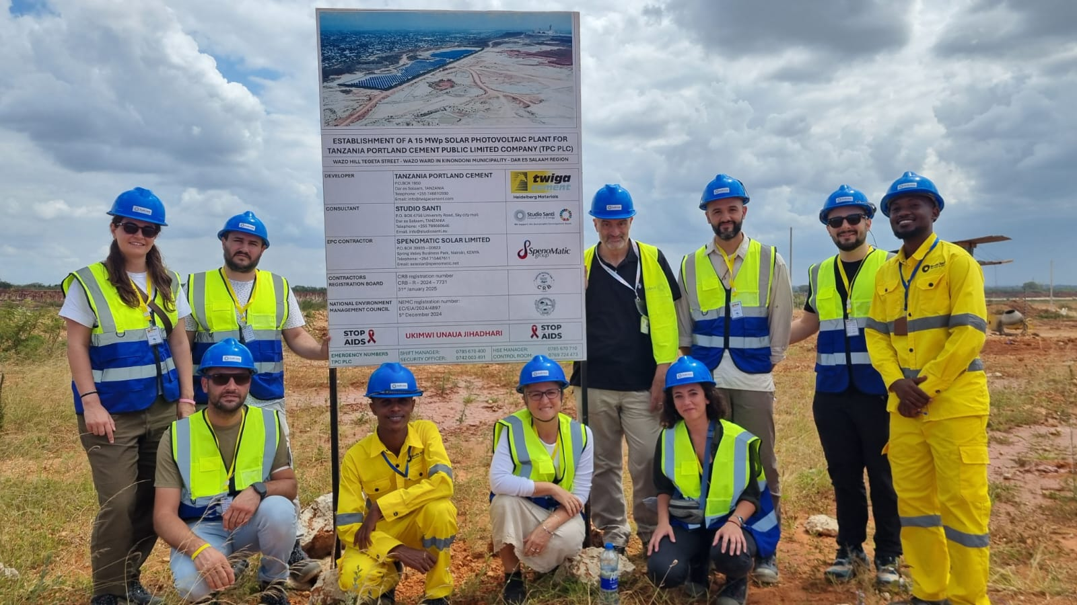
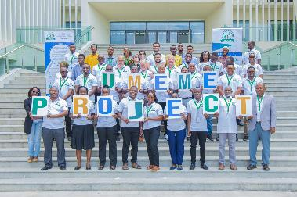
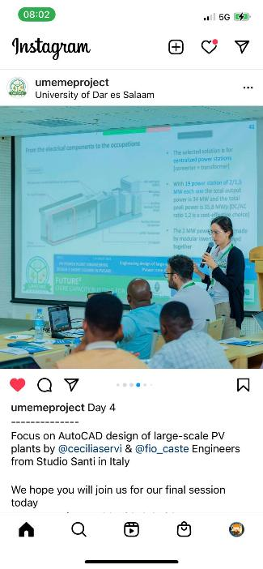

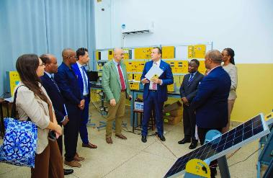

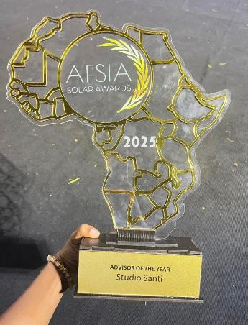
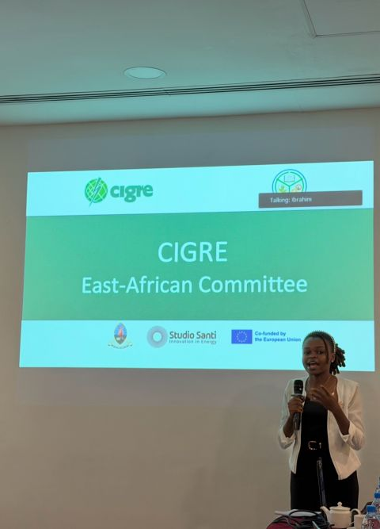
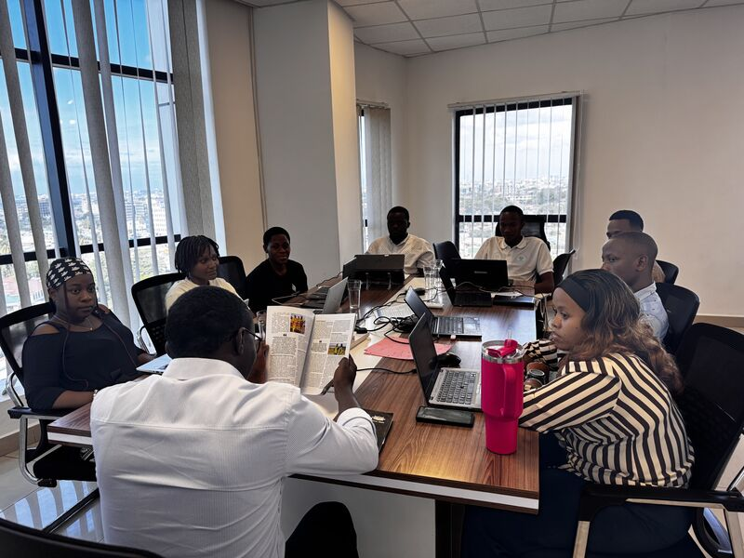
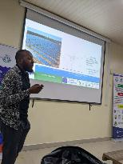
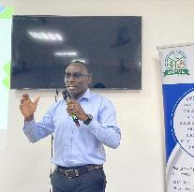
Capacity building is always at the heart of cooperation activities between Europe and Tanzania
a new edUcation systeM for Electric
access developMEnt in Tanzania
Currently other 9 Tanzanian engineers
are on training at Studio Santi Ltd in DSM tutored by their Tanzanian Colleagues
AFSIA Africa Solar Industry Association
Studio Santi Ltd Advisor Of The Year 2025

