Slide 1


TANZANIA EUROPEAN UNION
THEMATIC INVESTMENT ROAD SHOWS
05 - 06 October, 2026, HUGE, NETHERLANDS
INVEST IN AGRIBUSINESS- IN TANZANA
UNITED REPUBLIC OF TANZANIA | MINISTRY OF AGRICULTURE | EU ROADSHOW

Slide 2


THE COMBINED OPPORTUNITY
UNITED REPUBLIC OF TANZANIA
DIRA 2050 Ambitions
Total GDP: USD $1 trillion (up from roughly $87–$92 billion)
GDP Per Capita: At least USD $7,000 (up from roughly $1,277)
Population: Approximately 118 million people by 2050 up from 70+m in 2026.
Tanzania Agriculture Master Plan 2050 Ambitions
AGRICULTURE, LIVESTOCK & FISHERIES INVESTMENT OPPORTUNITIES
US$100B+20B
US$100B AgGDP Contribution target & and US$20B export ambition by 2050
Converting Tanzania's food, livestock and fisheries surplus into six bankable regional investment platforms
Agriculture, Livestock and Fisheries Economic growth
7% + 1.8%
MINISTRY OF AGRICULTURE
MINISTRY OF LIVESTOCK & FISHERIES
wheat · Edible Oils. ·Cofee.cashew. Avocado
combined GDP contribution — livestock & fisheries
Red Meat · Dairy · Blue Economy
US$3.73B up to US$6B
Status: Investment-ready priority pipeline – Tanzania Agriculture Master Plan 2050 (AMP 2050)
agricultural export earnings should rise from US$ 3.73B in 2024/25 to US$6B by 2030.
12M+
Owner: Ministry of Agriculture · Ministry of Livestock and Fisheries, United Republic of Tanzania
Coordinating Body: Agriculture Transformation Office (ATO)
households & workers across both sectors

Slide 3
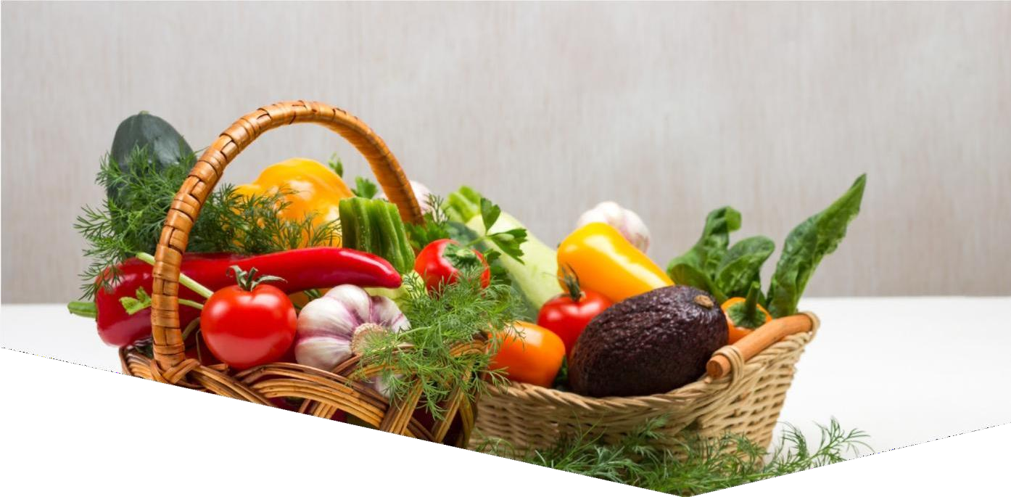
Feed Ourselves,
Feed Others Commercially
Our Vision
03

Slide 4




Objectives of the Tanzania Agriculture Sector
Increase production and productivity;
Increase decent jobs and enhancing youth and women participation in agriculture sector
To improve resilience for food and nutrition security
Strengthen access to market and agriculture financing
Strengthen cooperative development
Strengthen Digitalization
04

Slide 5
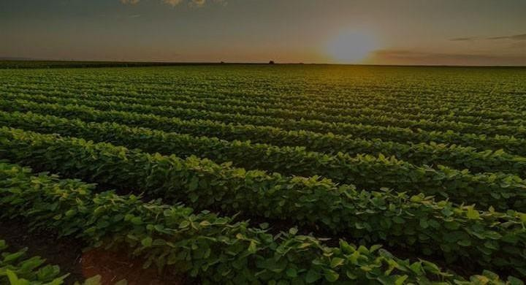



POTENTIAL VALUECHAINS FOR TRADE AND
INVESTMENT
 | Wheat | Edible Oil (Sunflower) | Horticulture (Avocado)
Objective | Reduce imports (%) (90 to 50) | Edible Oil (Sunflower) | Increase export
Current Production | 115,826 MT | 300,000 MT | 190,000 MT
Target Production by 2030 | 1,000,000 MT | 3,000,000 MT | 290,000 MT
Potential Investment Areas | Partnership in scaling up production | Partnership in scaling up production & processing | Partnership in scaling up production & export
08

Slide 6
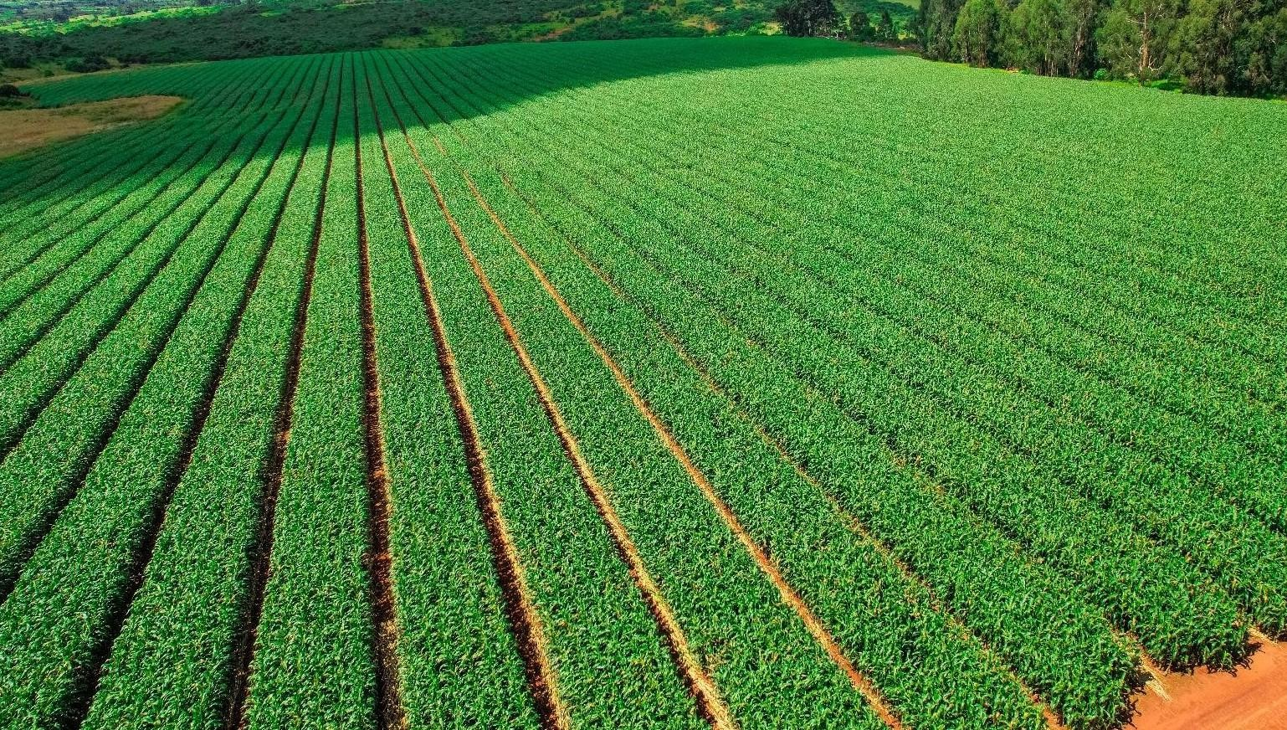



POTENTIAL VALUECHAINS FOR TRADE AND
INVESTMENT
Soya Palm Oil
beans
Maize
Objective
Increase production (%) Increase production (%)
from 24 to 76 from 16 to 84
48,000 MT 51,834 MT
500,000 MT 1,000,000 MT
Increase export
Current Production
10,719,000 MT
Target Production by 2030
18,772,000 MT
Potential Investment
Areas
Partnership in scaling up production & processing
Partnership in scaling up production & processing
Partnership in scaling up
production & export
*by 2030
06

Slide 7
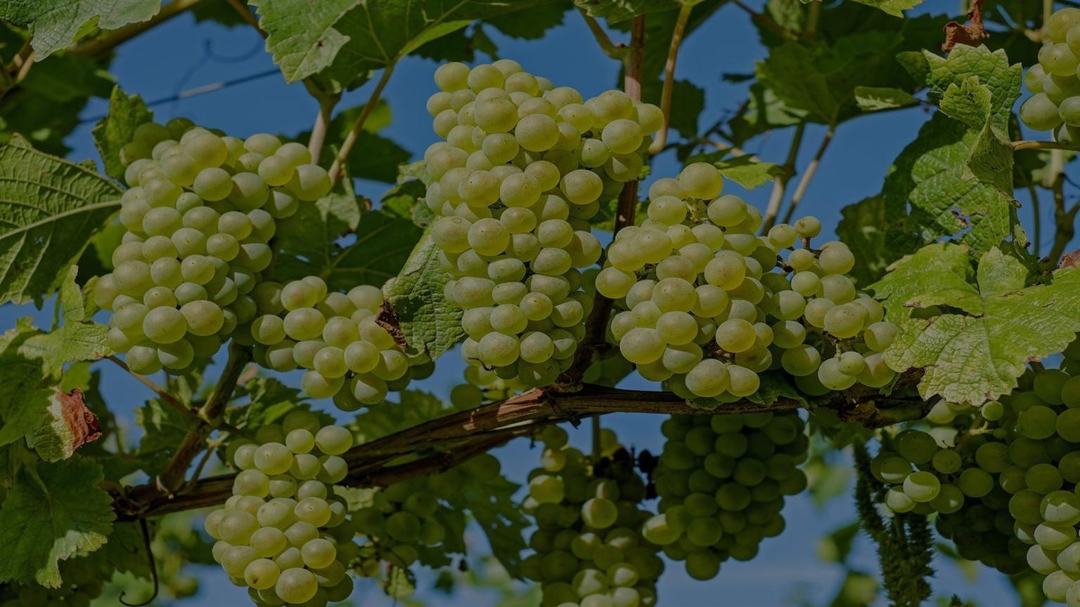





POTENTIAL PRODUCTIVITY AREAS FOR
TRADE AND INVESTMENT
 | Fertilizer | Seed | Irrigation
Objective | Substitute imports | Substitute imports | Increase area under irrigation
Current Production | 158,628 MT | 56,000 MT | 983,000 Ha
Target Production* | 1,000,000 MT | 650, 000 MT | 5,000,000 Ha
Potential Investment Areas | Partnership in fertilizer blending facilities and lime industries | Partnership in scaling up seed production | Partnership in irrigation technologies _{*by 2030} 07
49,880 MT

Slide 8
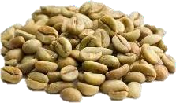
Coffee Value Chain
Project: Premium Coffee Cooperative – EU Trader Partnership Programme
Key opportunities
More than 600 AMCOS
Improved coffee quality
Traceability
Compliance
Branding
Access to international markets
EUDR compliance
Opportunity is ready for immediate engagement through Expressions of Interest (EOI).

Slide 9
TANZANIA COFFEE BOARD · INVESTMENT PROPOSAL FOR EU TRADERS
Investing in Tanzania's premium coffee supply
Long-term forward sales with organised cooperatives, backed by importer capital that is recovered through the same coffee deliveries.
43%
9–13%
600+
$413M
of Tanzania's coffee exports went to the EU in 2025/26, its #1 market
estimated annual growth of the European specialty market
coffee cooperatives (AMCOS), alongside 110 estates
export earnings from Arabica and Robusta in 2025/26

Slide 10
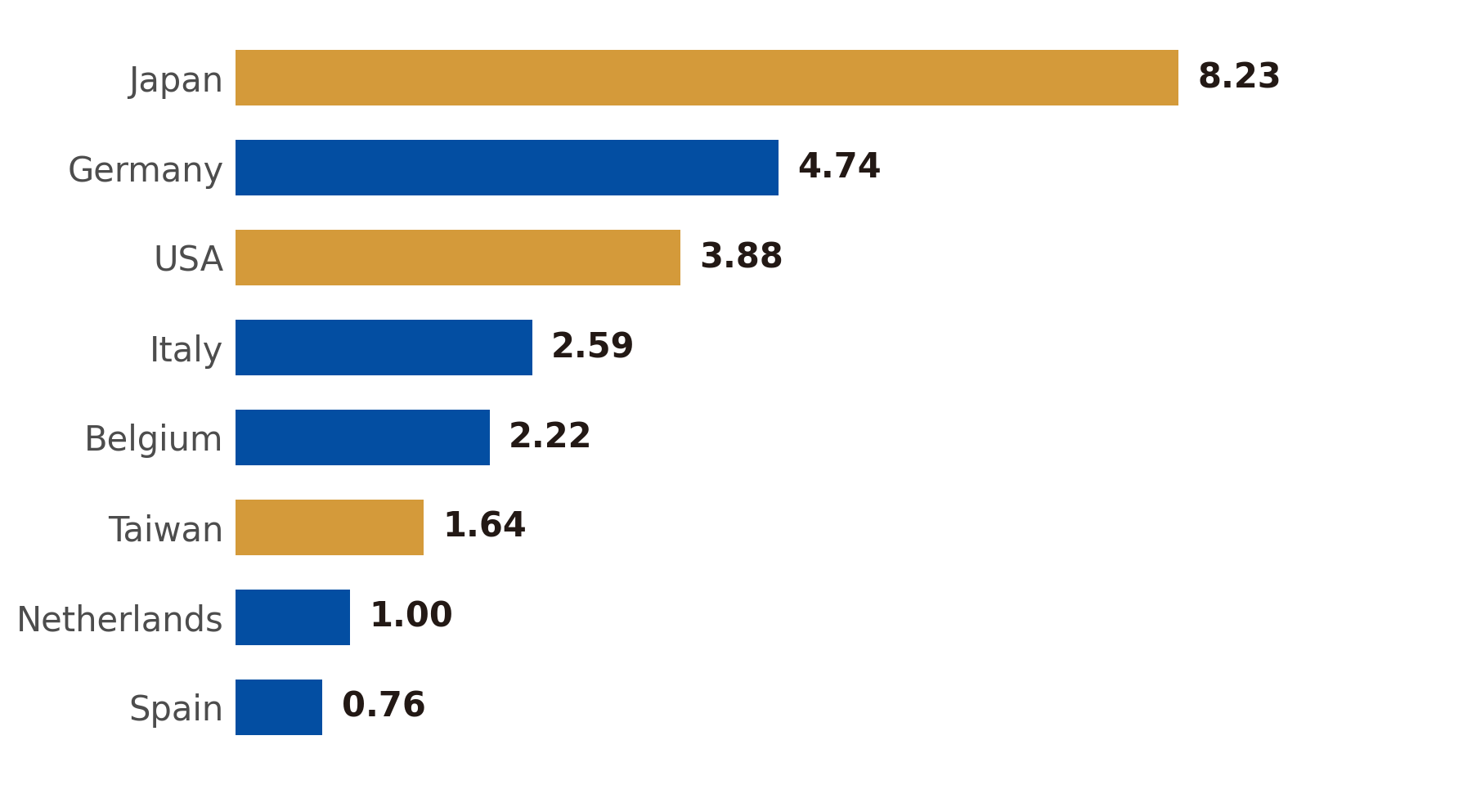
Where Tanzanian coffee went in 2025/26
Top destinations, million kg ■ EU markets
SHARE OF EXPORTS BY REGION
43%
38.0%
European Union
14.5M kg
Asia
13.1%
6.1%
North America
Africa, Oceania and other Europe
Total exports: 75,984,213 Tons worth $413.42 M. Asia and North America together take 51%, so EU buyers compete for supply

Slide 11
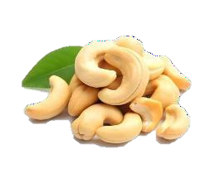
Cashew Value Chain
Project: Maranje Cashew Industrial Park
Investment components:
Cashew kernel processing
Cashew Nut Shell Liquid (CNSL) and other by-products
Drying facilities
Warehouses
Food laboratories
Complementary industrial activities
Indicative investment: USD 137 million
Equivalent: Approximately TZS 343.4 billion
Objective: Increase domestic processing, value addition and employment.

Slide 12
Where Tanzanian cashew kernels went in 2025/26
MARKET MIX
Top destination markets • quantity exported (million kg)
1.51
European Union
29.3%
China
1.63M kg
1.34
Netherlands
33.7%
0.43
Asia
1.88M kg
Algeria
0.35
India
Africa
15.3%
0.20
0.85M kg
Kenya
0.18
11.7%
Vietnam
Middle East
0.17
0.65M kg
Kuwait
0.15
North America
0.7%
Austria
0.04M kg
0.15
United Arab Emirates
0.14
EXPORT FOOTPRINT
31 destination markets • 5.57M kg • $31.32M FOB value

Slide 13

Trading Opportunities in Horticultural Crops

Slide 14
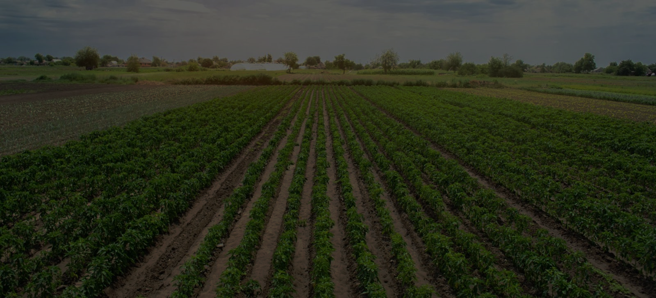


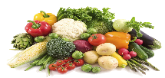



HORTICULTURE EXPORT 2017 - 2025
EXPORT VALUE | USD
2030 EXPORT AMBITION
4.0×
$2.0B
BY 2030
31.6%
annual growth required
from 2025 to 2030
12.4%
historical CAGR
2017–2025*
31.6%
Source: TAHA design using BoT and Economic Survey reports (various)
THE PACE MUST ACCELERATE
Fruits
Vegetables
Flowers
Roots & Tubers
Spices & Herbs
Horticultural Nuts

Slide 15
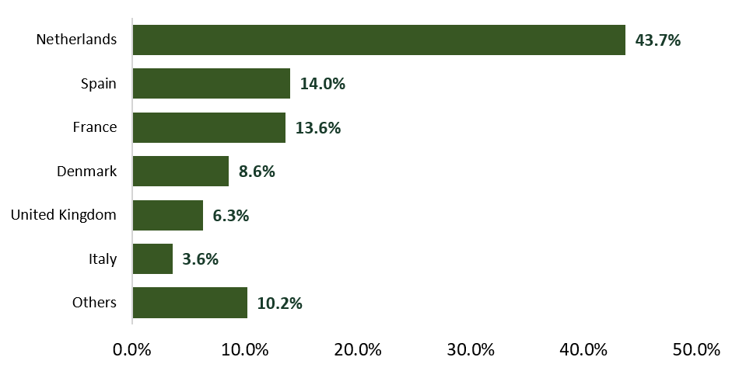
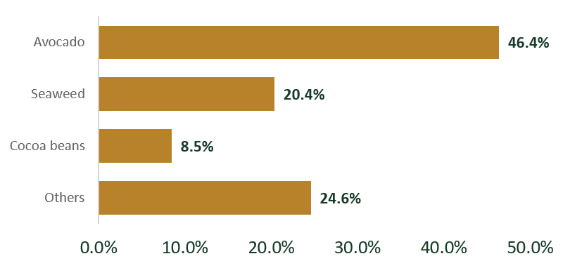
Horticulture exports to Europe
36.3%
Share of total exports by region
36.3%
32.5%
27.6%
3.5%
0.1%
of total exports
Europe
Asia
Africa
North America
Oceania
Top 3 Crops exported to Europe
Leading European destinations
Source: TAHA design using TRA and Economic Survey reports (various), 2025

Slide 16
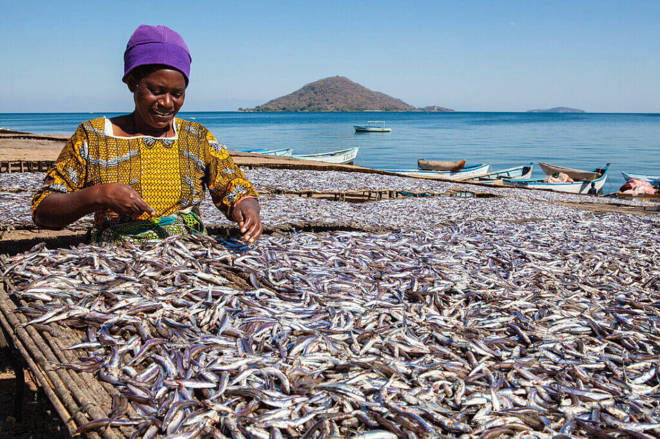
INVESTMENT OPPORTUNITIES
IN THE LIVESTOCK AND FISHERIES SECTOR
40.6M
29.6M
9.9M
113.4M
4.4M
Goats
Sheep
Chickens
Pigs
Cattle
Fisheries & Aquatic Resources
Freshwater resources: 61,500 km²
Coastline: 1,424 km
Territorial waters: 64,000 km²
EEZ: 223,000 km²
Fisheries growth: 1.5%; GDP contribution: 1.8%.
INVESTMENT OPPORTUNITIES IN LIVESTOCK AND FISHERIES SECTOR | TANZANIA
2

Slide 17



Three Priority Value Chains
Scale of the opportunity, and where European investors enter
RED MEAT
DAIRY
FISHERIES & BLUE ECONOMY
SCALE & SIGNAL
SCALE & SIGNAL
SCALE & SIGNAL
40.6m cattle, 29.6m goats & 9.9m sheep. 27 slaughter facilities (7 export-certified); 2 already exporting 14,000 MT to Saudi Arabia.
4.6m households employed. Projected 5.8m-litre milk gap by 2030. Packaging & dairy ingredients currently imported.
1,424 km coastline; 12 large-scale processing plants. Fingerling supply 51.3m vs. 120m demand.
INVESTOR ENTRY POINTS
INVESTOR ENTRY POINTS
INVESTOR ENTRY POINTS
Ranching, NARCO sub-leasing, feedlotting, export production, modern abattoirs.
Specialised dairy breeds, milk-packaging plant, dairy-ingredient manufacturing.
EEZ tuna fishing, TAFICO JV, cold-chain, fingerling hatcheries, Kilwa Port PPP.
7 / 10

Slide 18



Flagship Projects & The Financing Ask
Open investor calls, built on an existing production base
FLAGSHIP PROJECTS
THE FINANCING ASK
NARCO Ranching & Export Abattoir Corridor
Red Meat
~500,000 ha available for sub-leasing; scale-up from 2 to 7 export-certified abattoirs.
Open investor call — ranching, feedlotting & abattoir scale-up.
Forage-to-Feed Value Chain
Dairy
Closes the 146.9m MT/yr forage gap and the maize-for-feed gap via pasture, maize & soybean.
Open investor call — dairy-breed, feed & ingredient plants.
Kilwa Port & EEZ Blue Economy Corridor
Fisheries
PPP-ready fishing port anchoring processing, cold-chain & EEZ tuna landings.
Kilwa Port PPP + open investor call — processing & aquaculture.
Delivery via ATO, the Ministry of Livestock and Fisheries, NARCO, TAFICO and TISEZA.
Note: indicative ticket sizes were not specified in the underlying sector brief; each window is an open investor call pending feasibility costing.
UNITED REPUBLIC OF TANZANIA | LIVESTOCK & FISHERIES INVESTMENT PLATFORM
8 / 10

Slide 19



Enabling Environment & Delivery Model
14,000 MT
12
27
meat already exported to Saudi Arabia
large-scale fish-processing plants operating
modern slaughter facilities (7 export-certified)
INCENTIVES
DELIVERY MODEL
Fiscal incentives — TISEZA corporate-tax exemption, withholding-tax relief, and VAT exemption capital goods,
Ministry of Agriculture
Ministry of Livestock & Fisheries — policy & technical
Special Economic Zones — EPZ remission of customs duty
Trade facilitation — one-stop border posts for permits & certificates.
TISEZA — investment facilitation & incentives
NARCO — rangeland sub-leasing · TAFICO — EEZ & aquaculture JVs
Tanzania Agricultural Development Bank (TADB) — Official Agricultural Financing Platform
Strategic fit: food & nutrition security · rural livelihoods · export diversification · Blue Economy growth
Contact: Ministry of Agriculture- Dodoma; Ministry of Livestock and Fisheries, Dodoma

Slide 20
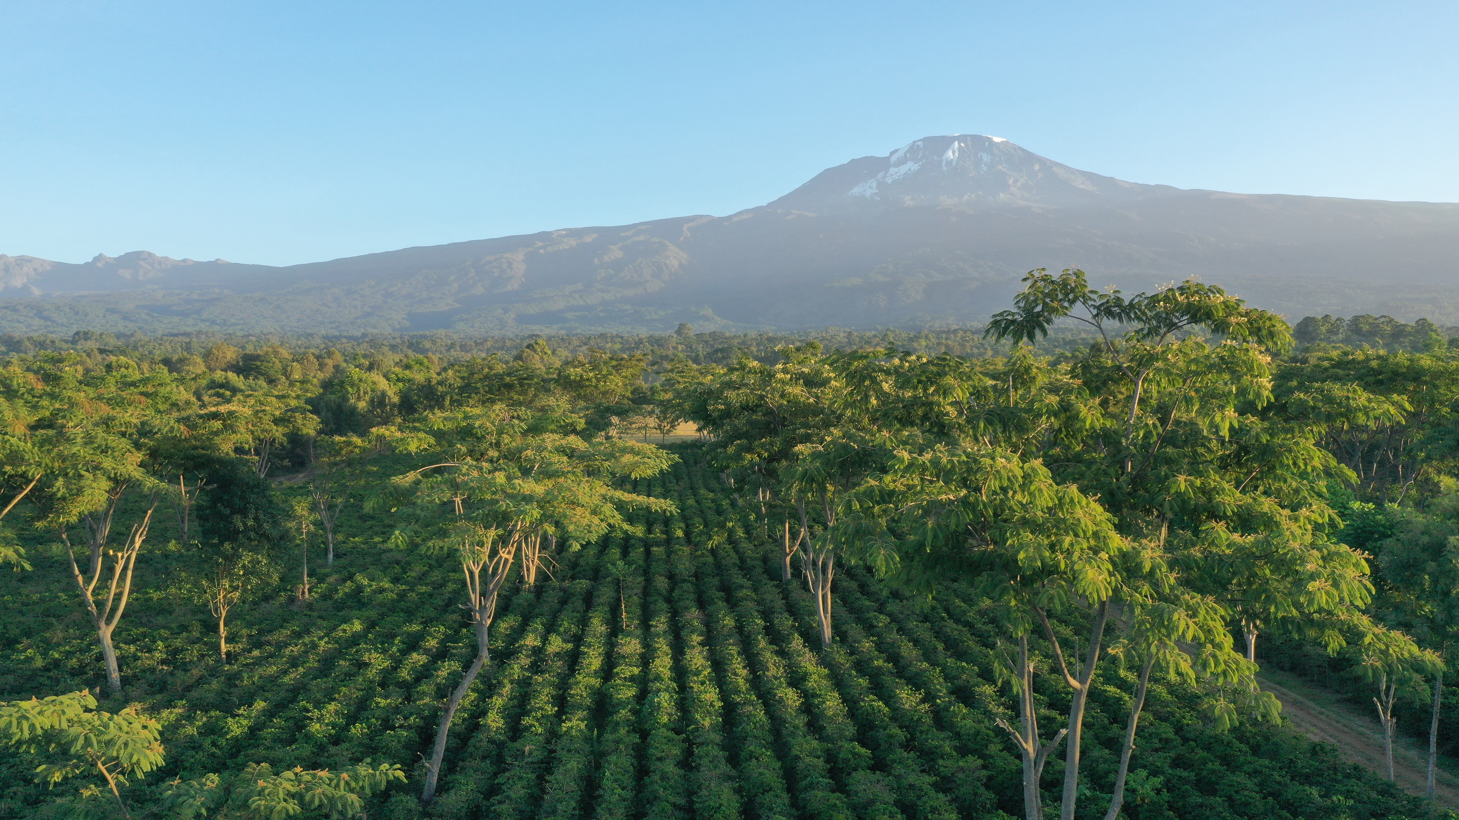



We Call European Partners to invest in Agriculture Sector in Tanzania; where we consider green growth and inclusive economy

