Slide 1



EU - TANZANIA INVESTMENT AND BUSINESS FORUM
Powering Tanzania's Growth
Electricity Sector Overview & Investment Opportunities
Styden Rwebangila (PEng.)
Assistant Commissioner for Electricity Development · Ministry of Energy
SEPTEMBER -OCTOBER 2026

Slide 2


01 · CAPACITY & DEMAND
Installed Capacity and Demand Overview
INSTALLED CAPACITY
PEAK DEMAND
4.6 GW
2,505.86 MW
total country power capacity
recorded maximum demand, June 17, 2026
Grid installed capacity
4,038.95 MW
Main grid demand
2,114.55 MW
Off-grid installed capacity
90.7 MW
Off-grid demand
75.0 MW
Private generation (own use)
390.22 MW
Own-use demand
360 MW
Cross-border imports
67 MW
Electricity customer base
5.689 million
CAPACITY VS. PEAK DEMAND (MW)
10–15%
Government target: 8GW installed capacity by 2030 and 70GW by 2050
annual demand
growth rate
CAPACITY & DEMAND
3

Slide 3
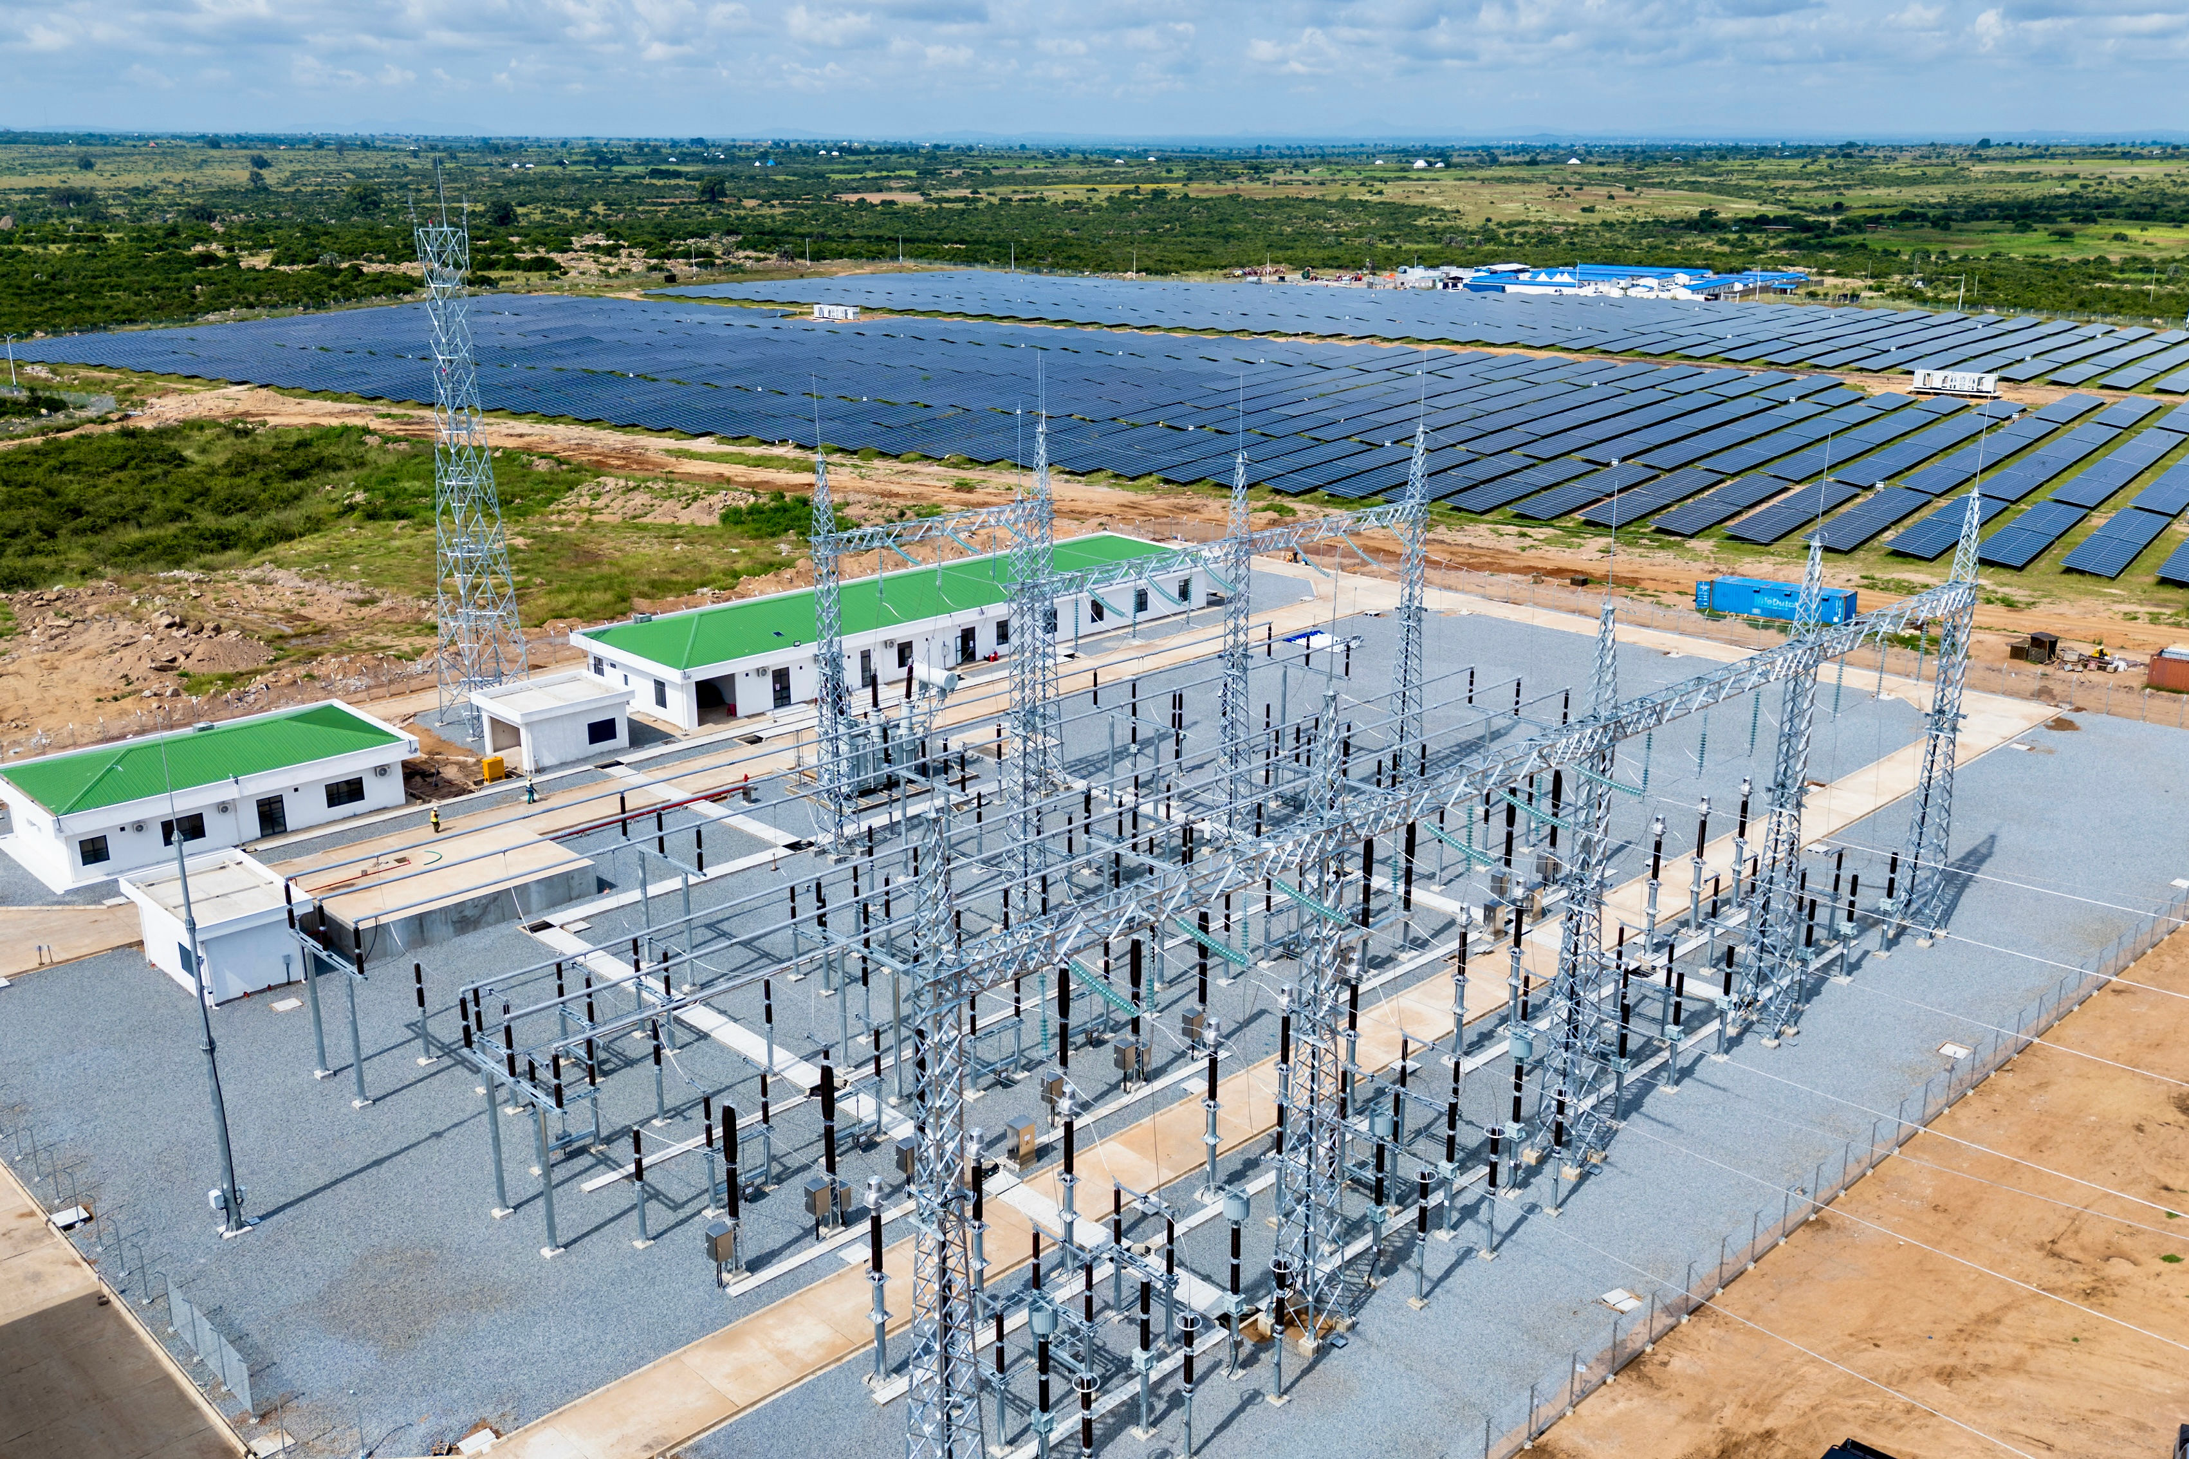
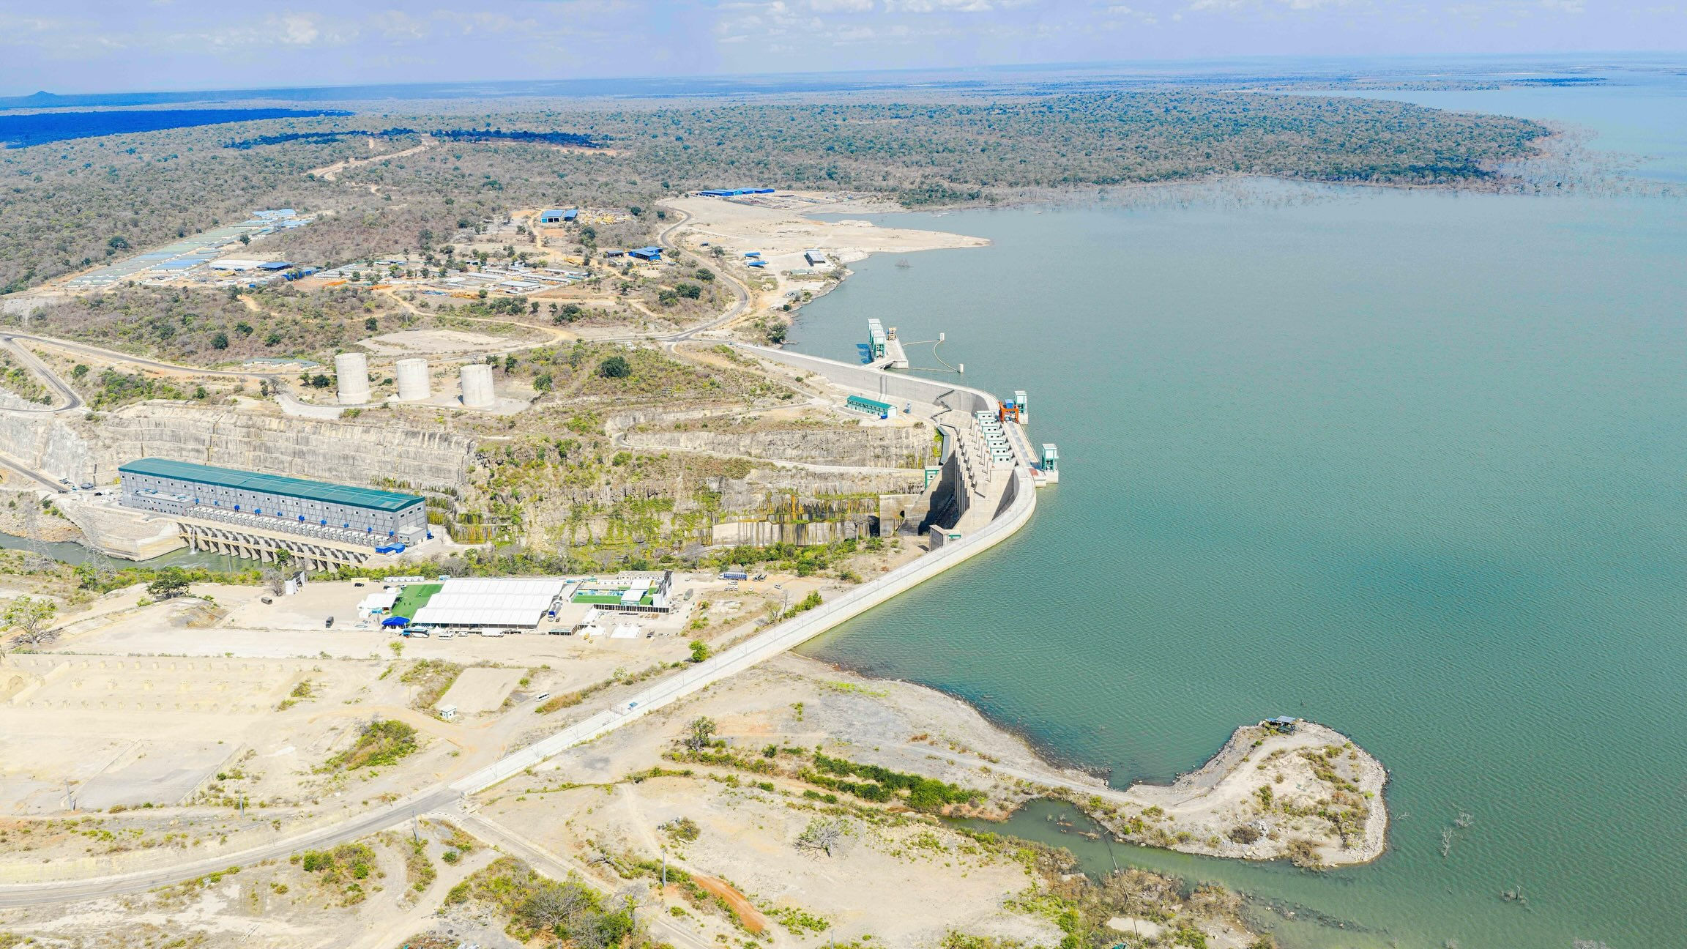
03 · PROJECTS PIPELINE
Power Generation Projects Under Construction
Generation projects underway total 3,814.3 MW — a core contributor toward the Government's 8,000 MW by 2030 target
PROJECT CAPACITY (MW)
Kishapu 150MWp Solar generation — renewable diversification
2,115MW JNHPP — hydropower heartland
PROJECTS PIPELINE
8

Slide 4
04 · INFRASTRUCTURE
Transmission and Distribution Lines
TRANSMISSION LINES BY VOLTAGE (KM)
DISTRIBUTION LINES BY VOLTAGE (KM)
33 kV
58,886.56 km
26.6%
11 kV
12,986.25 km
5.9%
0.4 kV
105,387.74 km
47.7%
221,110.65 km total distribution network
8,519.34 km total transmission network
Together, over 229,600 km of lines connect generation to 5.689 million customers nationwide — a network scaled for continued grid densification and industrial off-take.
TRANSMISSION & DISTRIBUTION
6

Slide 5
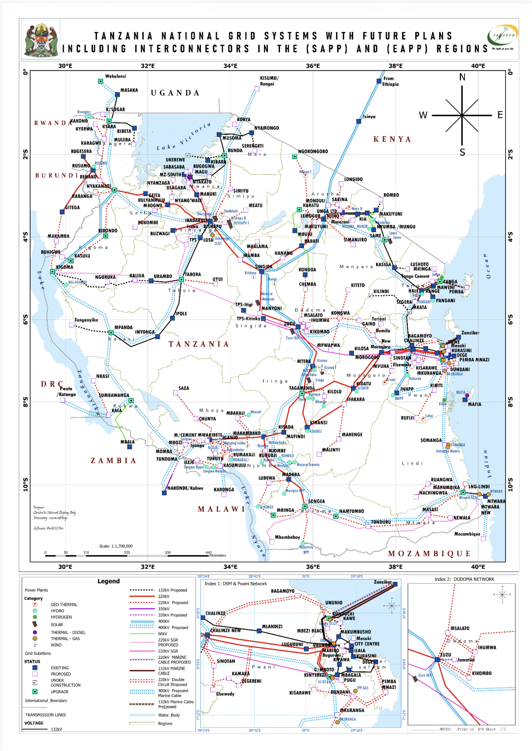



04 · INFRASTRUCTURE
National Grid & Regional Interconnection
Tanzania's grid is being built as a regional platform — not just a national network.
SAPP & EAPP Interconnection
The national grid links into both the Southern Africa Power Pool (SAPP) and the East Africa Power Pool (EAPP), positioning Tanzania as a regional energy transit hub.
Cross-border Transmission Corridors
Active and planned interconnectors with Zambia, Uganda, Kenya and neighbouring states expand the addressable market beyond Tanzania's borders.
Backbone for Industrial Growth
400kV and 220kV corridors extend supply toward mining, agro-processing and the Standard Gauge Railway, anchoring demand for new generation.
TRANSMISSION & DISTRIBUTION
7

Slide 6



05 · PRIVATE SECTOR PARTICIPATION
Opening the Market: Power Generation
The Government is implementing a number of reforms to attract private investment in power generation and transmission through IPP, IPT and PPP models.
Bankable Agreements
Risk Allocation Framework
Pilot Renewable Projects
Model Power Purchase Agreements (PPAs) and Implementation Agreements for IPPs have been revised to address bankability issues that previously slowed financial close.
A Technical Advisor has been engaged to undertake risk assessment and propose risk allocation and mitigation facilities for IPP projects.
Two pilot renewable energy projects are being packaged for demonstration — a template for future IPP and PPP transactions in generation.
IPP / PPP Revised PPAs and a dedicated risk-mitigation framework are de-risking entry for private generation investors
PRIVATE SECTOR PARTICIPATION
11

Slide 7
05 · PRIVATE SECTOR PARTICIPATION
Roadmap for Transmission (IPT / PPP)
For IPT and PPP on power transmission, the Government is implementing a roadmap of seven steps:
1
2
3
4
Review of enabling policy, regulatory and legal conditions
Identification and validation of the project pipeline, including a pilot
Preparation of tendering and contractual documents
Financial analysis to determine IPT absorption capacity and credit-enhancement needs
5
6
7
Developing bankable IPT/PPP structures and organizing market sounding
Pre-feasibility studies for the pilot IPT/PPP and facilitation of land acquisition
Tendering of projects
PRIVATE SECTOR PARTICIPATION
12

Slide 8




07 · INVESTMENT CASE
Why Tanzania's Power Sector, Why Now
A Reformed, Bankable Framework
A Demand Curve Outpacing Supply
Demand is growing 10–15% a year against 4.6 GW of installed capacity — headroom for new generation and transmission investment.
A Clear Government Target
Revised PPAs, a dedicated risk-mitigation facility, and a defined IPT/PPP roadmap lower the barriers to entry for foreign investors.
The plan to reach 8GW by 2030 and 70GW by 2050 leave a substantial capacity gap for private and co-financed projects to fill.
Shovel-Ready Financing Needs
A Regional Energy Hub
Room to Diversify
US$237 million for North East Grid Phase II and US$ 407.84 million for the Uganda interconnection are seeking co-financing partners today together with US$ 4.039 billion needed from private sector for Tanzania Mission 3000
SAPP and EAPP interconnections position Tanzania to serve markets well beyond its own borders.
Solar and wind together supply under 1.5% of capacity today — wide open ground for renewable-focused investment.
THE INVESTMENT CASE
13

Slide 9
THANK YOU
Karibu Tanzania — let's power growth together
Styden Rwebangila (PEng.)
Assistant Commissioner for Electricity Development
Ministry of Energy, United Republic of Tanzania
EU TANZANIA INVESTMENT AND BUSINESS FORUM SEPTEMBER – OCTOBER 2026

